Slide 1
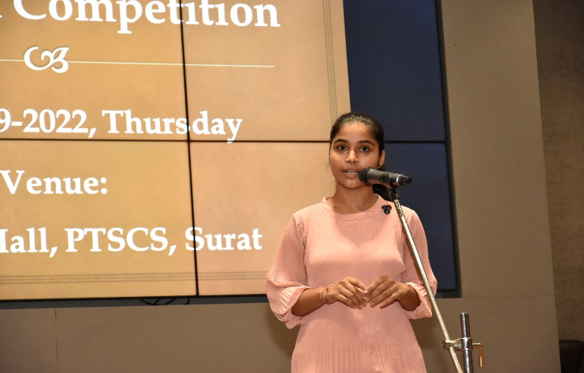
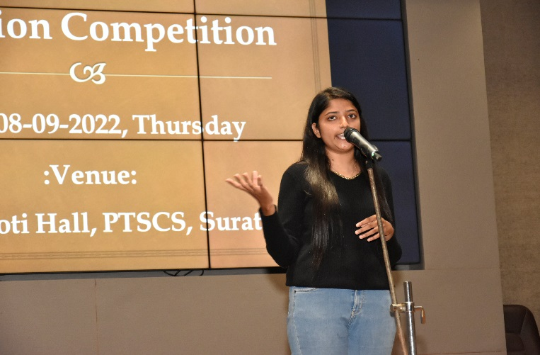
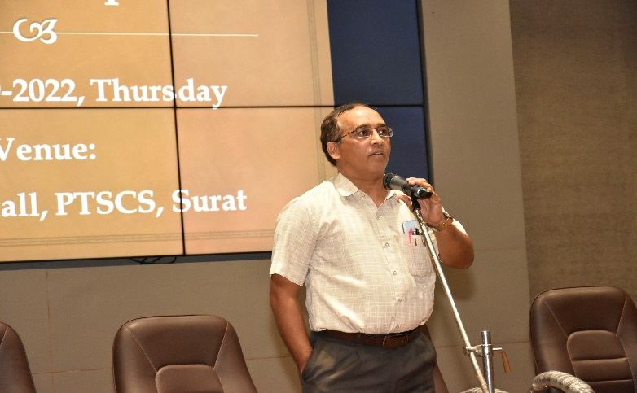
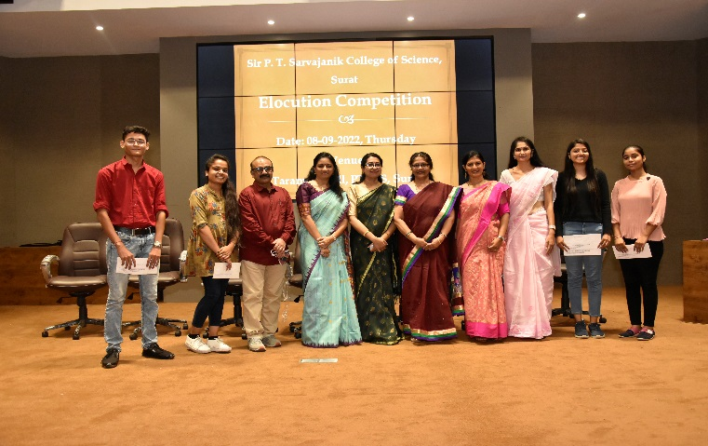
Elocution Competition:
Date: 8th September , 2022
Participants: 31
Brief Report:
With a view to motivating the oratory skill of our students, an elocution competition was organized for the students of our college on 8-9-2022. The topics were:
1. Treat others the way you wish to be treated
2. Internet kills communication
3. There’s no time like the present
Dr. Neelam Mishra, Dr. Janki Vashi and Dr. Sutapa Mondal Roy rendered their service as the judges.
The winners were:
First: Patel Hetanshi J. (T.Y.B.Sc.)
Second: Thakur Kajalsingh S. (S.Y.B.Sc.)
Third : Oza Vishwa H. (F.Y.B.Sc.)
Appreciation Prize :
1. Bhutwala Devansh D. (F.Y.B.Sc.) , 2. Merchant Kashish (F.Y.B.Sc.)
Prof. Priti Singaraju organized and conducted this event successfully. Dr. Khagen Chauhan, Dr. Jagruti Rana, Ms. Krishna Chevli and Mr. Jay Sevalia assisted to make this event a great success.

